Slide 1

AmnioTrack: Revolutionizing Amniotic Fluid Monitoring
An innovative solution for continuous amniotic fluid monitoring. Our team has developed a groundbreaking technology to enhance prenatal care and reduce risks associated with abnormal amniotic fluid levels.
By,
Abu Bakar Siddik
Manmeet Kaur
Khandaker Fahima Ahmad

Slide 2
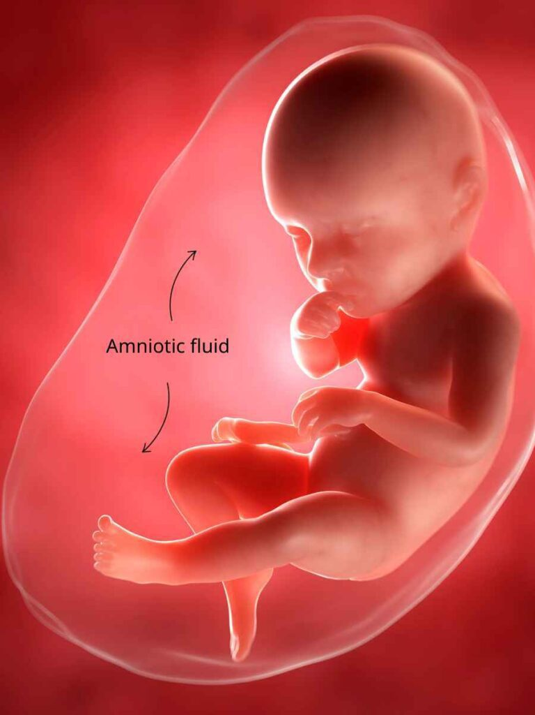
Index –
Introduction
Importance of Amnio Fluid
Current Monitoring Limitations
Proposed Solution
Work Process
Demo
Advantages
Challenges

Slide 3
Importance of Amniotic Fluid –
Protection
Developmental Support
Temperature Regulation
Infection Barrier
Lung Development
Important Terms –
Too Little Fluid (Oligohydramnios)
Too Much Fluid (Polyhydramnios)

Slide 4

The Problem: Current Monitoring Limitations
Infrequent Checks
Current methods rely on periodic ultrasounds, potentially missing crucial changes between appointments.
Invasive Procedures
Some diagnostic techniques are invasive, causing discomfort and carrying risks for both mother and fetus.
Delayed Detection
Abnormalities may go unnoticed until they become severe, leading to complications in pregnancy.

Slide 5
Introducing AmnioTrack: Our Innovative Solution
Bioimpedance Technology
Non-Invasive Monitoring
AI-Powered Analysis
Our patch adheres comfortably to the mother's abdomen, providing real-time data without invasive procedures.
Sophisticated algorithms analyze data trends, predicting potential issues before they become critical.
AmnioAI utilizes advanced bioimpedance sensors to measure amniotic fluid levels accurately and continuously.

Slide 6

How AmnioTrack Works?
1
Data Collection
The AmnioAI patch continuously measures bioimpedance signals from the mother's abdomen.
2
Secure Transmission
Collected data is securely transmitted to the user's smartphone via Bluetooth Low Energy.
3
AI Analysis
Our proprietary AI algorithms process the data, identifying patterns and potential abnormalities.
4
Real-Time Feedback
Users receive instant notifications and insights through the AmnioTrack mobile app.

Slide 7



AmnioAI Mobile App Interface
Real-Time Tracking
AI Insights
Instant Alerts
Monitor amniotic fluid levels with easy-to-read graphs and historical data.
Receive personalized insights and recommendations based on your data.
Get immediate notifications for any concerning changes in amniotic fluid levels.

Slide 8
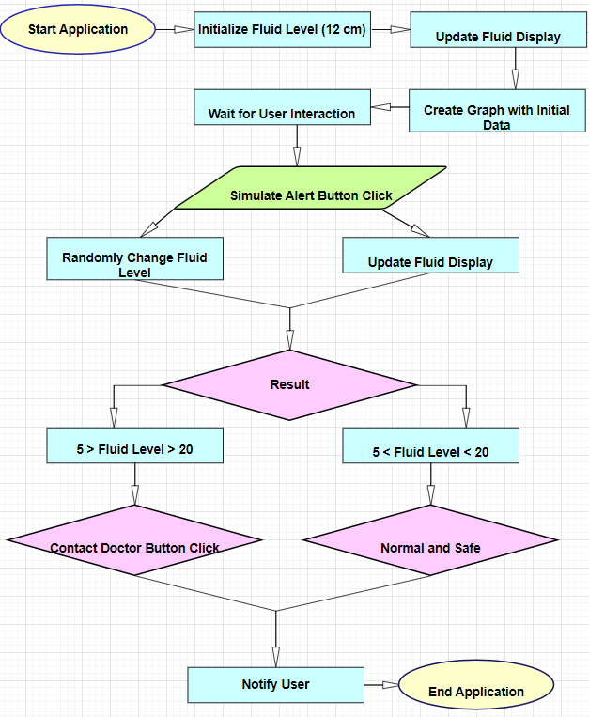

Slide 9





Benefits of AmnioAI
Enhanced Safety
Continuous monitoring reduces the risk of undetected complications.
Improved Care
Healthcare providers can make more informed decisions with real-time data.
Peace of Mind
Mothers experience less anxiety with constant monitoring and instant alerts.
Long-Term Impact
AmnioAI has the potential to revolutionize prenatal care practices worldwide.

Slide 10





Challenges and Future Directions
Regulatory Approval
Navigate FDA and international regulatory processes for medical device approval.
Clinical Trials
Conduct extensive trials to validate AmnioAI's accuracy and effectiveness.
Integration
Seamlessly integrate AmnioAI with existing healthcare systems and EHRs.
Future Features
Explore additional pregnancy monitoring capabilities, such as fetal movement tracking.

Slide 11

Market Analysis
Global Prenatal Care Market
$6.51 billion by 2032
Target Audience
Pregnant women, OB/GYNs, Hospitals
Competitive Advantage
Continuous, non-invasive monitoring
Projected Market Share
15% within 5 years

Slide 12

Conclusion: The Future of Prenatal Care
1
Revolutionary Technology
AmnioAI represents a paradigm shift in amniotic fluid monitoring and prenatal care.
2
Improved Outcomes
Our solution has the potential to significantly reduce pregnancy complications and improve neonatal health.
3
Global Impact
We envision AmnioTrack becoming a standard of care in prenatal monitoring worldwide.
4
Continuous Innovation
Our team is committed to ongoing research and development to expand AmnioAI's capabilities.

Slide 13

Q&A Session
We appreciate your attention and interest in AmnioAI. We're now open to questions from the audience. Please feel free to ask about any aspect of our technology, market strategy, or future plans.

Slide 14


